Slide 1
Supercharge your career with
Open Source

Slide 2
Welcome to SINFO!
Notes:
I'd like to thank the organizers for inviting me to speak here today. I hope this will be useful for you. We should have time for questions in the end.

Slide 3
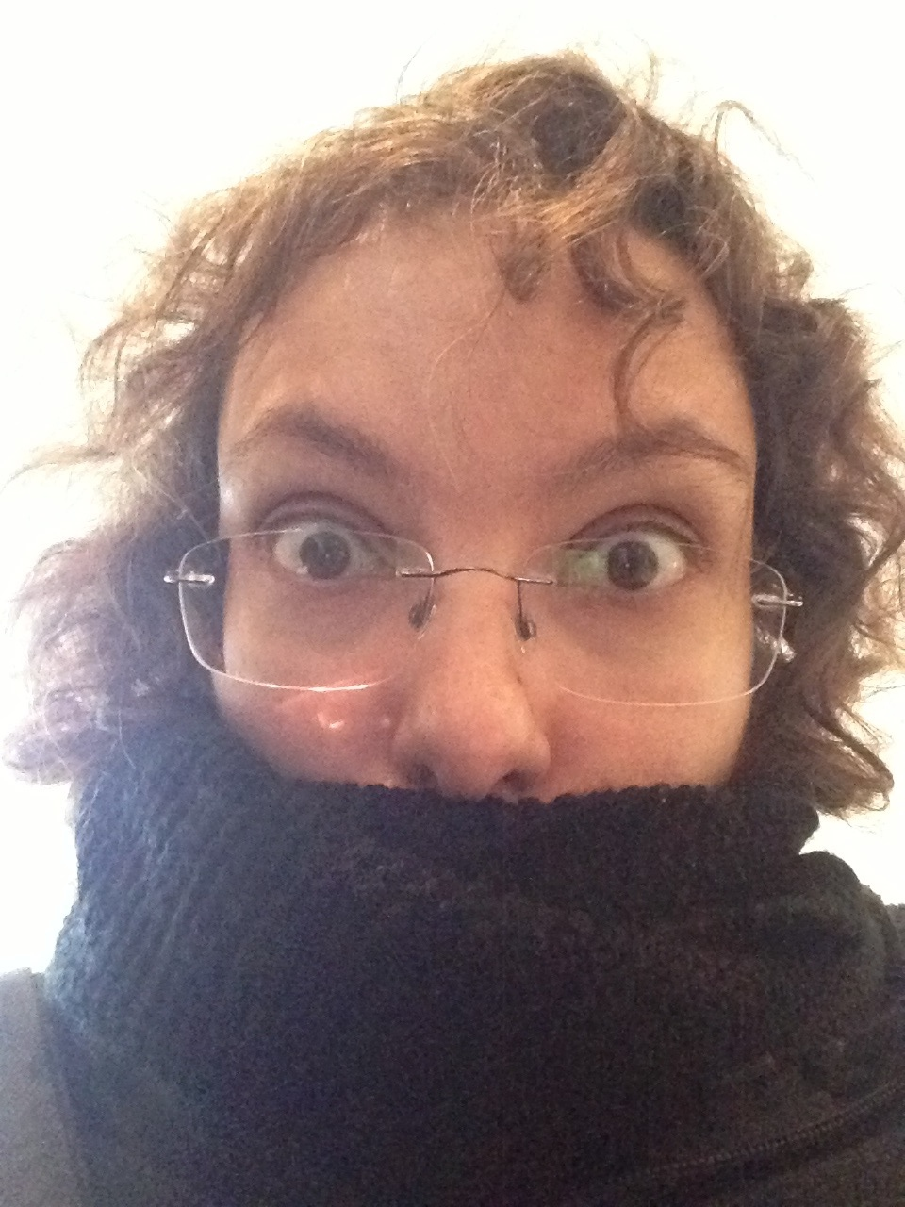


👋 Andreia “shana” Gaita
Editor Tools team lead @ GitHub
Runtime & scripting engineer @ Unity
Mono hacker @ Novell & Xamarin
sh4na (not a typo)
shana
Notes:
I am currently at GitHub and I'm the Editor Tools team lead. Before this, I was at Unity, Xamarin and Novell.
My day job for the last 12 years has been mostly open source work, and I've been in the tech industry for about 20 years.
I currently live in Copenhagen, Denmark, and I come back here regularly to remind me of what the sun looks like
So what do we do at GitHub? The Editor Tools team is responsible for integrating GitHub into tools like Visual Studio and Unity.

Slide 4
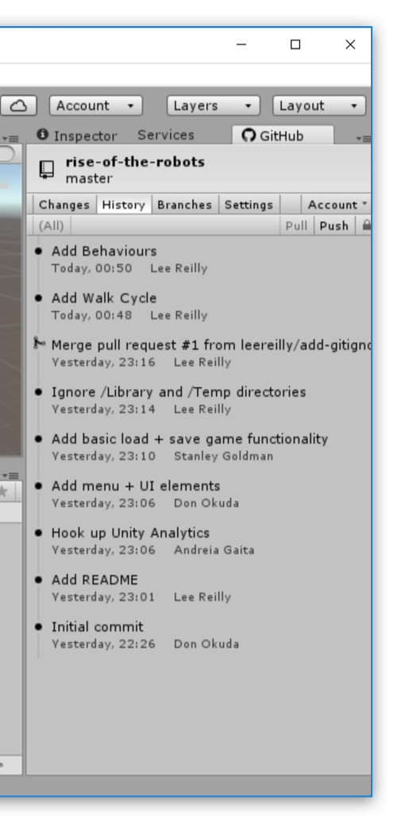
Visual Studio
Unity
Extensions
GraphQL
C++
C#
Notes:
We work in whatever language is required for the tool that we're building integrations for.
Every tool has its extensibility API and its preferred language for development. Visual Studio is C#, Unity is C# and C++, and something like Atom is javascript.
These are developer tools - basically build applications inside existing applications that extend existing functionality and provide new functionality for developers. Since we're GitHub, this is mostly about providing Git tools and UIs integrated into existing developer tools.
We have 300 thousand users using our integrations on a daily basis. In Visual Studio, we have all sorts of developers, ranging from open source maintainers and contributors to game developers, web developers, enterprise application developers.
No matter what you're doing in Visual Studio, at some point you're going to need to clone a repository from GitHub or publish your own project to it or share a gist of your code, and you'll be doing this through GitHub for Visual Studio.
In Unity our users are game developers working on mostly non-code assets – for code they can use Visual Studio.

Slide 5
Linux
VMs
Cross-platform
MacOS
Windows
Notes:
If the tool we're integrating into is cross-platform, then we do cross-platform development too. And to be honest, your preferred OS for development doesn't really have to match your target OS - I didn't even have a Windows machine until a year after I started building GitHub for Visual Studio, and Visual Studio is a Windows-only application - I use VMs and physical machines all the time, whatever is most convenient at the time.
Our main focus is putting GitHub in your developer tool, so desktop platforms are the extent of our cross-platform reach. In the past though, I've worked on projects that ran on one (or all!) of these platforms.

Slide 6
Raspberry
SmartTV
tvOS
Android TV
ARCore
Linux
VMs
Solaris
Android
iOS
Fire OS
Gameroom
WebGL
AR Kit
3DS
XBox One
Cross-platform
XBox 360
Rift
PS3
PSVR
BSD
Wii U
Cardboard
UWP
MacOS
WMR
Windows
PS4
PS Vita
Vive
Switch
Daydream
GearVR
Notes:
The code that targets these platforms runs on top of open source projects. This isn't a complete list of all the possible platforms out there that open source projects run on, it's just the list of things that I know my code has run on at one point or another.

Slide 7
All of our projects
are
Open Source
Notes:
All of our projects are open source. All of the work discussions and planning happens in our open source repositories on GitHub. In fact, all communication at GitHub itself happens on repositories, private and public. Everything from the project planning and design to legal contracts and marketing blurbs is handled in issues and pull requests across the entire github organization at github. We have over 2000 repositories in our org! As you can imagine, when you first join GitHub and get signed up for all the notifications across the org, it can be a tad overwhelming. This gif demonstrates what people first starting at GitHub usually feel like for the first month or so.

Slide 9
Check them out
https://github.com/github/VisualStudio
https://github.com/github-for-unity/Unity
Notes:
Our latest launch was GitHub for Unity last year at GDC. You can check our work at https://github.com/github/VisualStudio and https://github.com/github-for-unity/Unity

Slide 10
What's it like?
Notes:
So what's it like for me, working in open source?

Slide 11
Bologna
Seattle
San Diego
Distributed
New York
Copenhagen
Bristol
Notes:
We are a remote and distributed team. I'm currently in Copenhagen, Denmark and I have team mates in Bologne, Bristol, New York and San Diego.
Other teams at GitHub are even more distributed, with people in Japan and Australia. We cover most timezones across the globe, which sometimes is a good thing and sometimes is a bad thing.
Async communication
24 hour support
Waiting for a reply

Slide 12
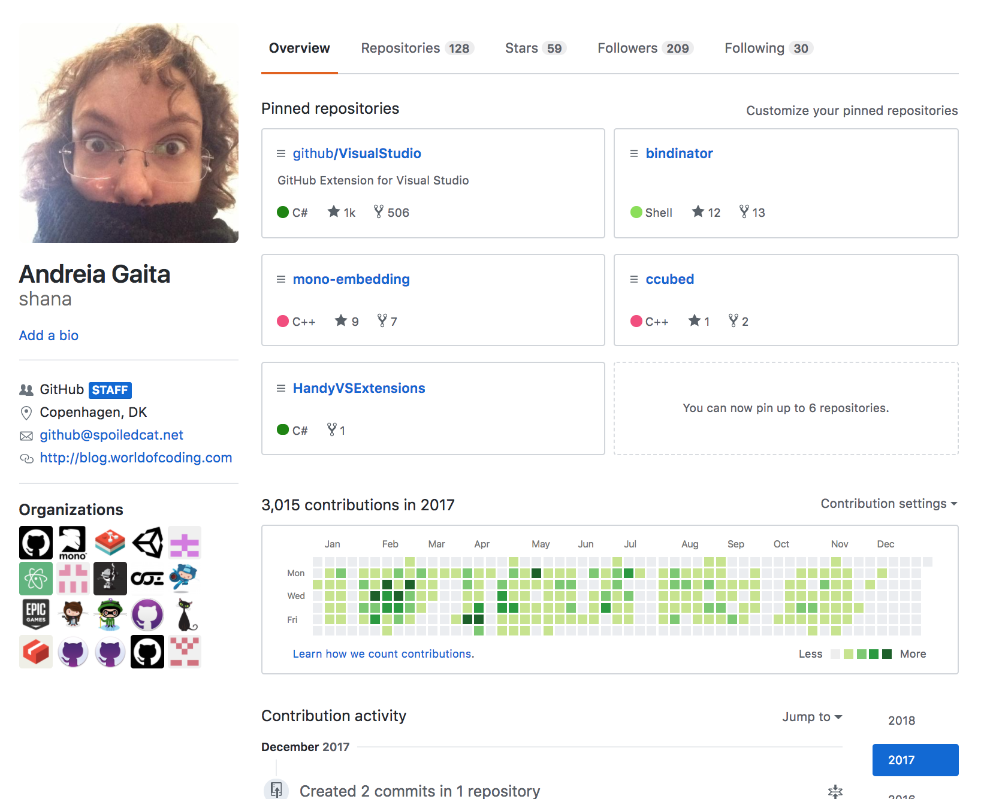
Notes:
My 2017 looked like this. Most of my work is available for anyone to see, and it's not just code, it's also project planning, design, discussions, releases, everything that goes into shipping projects.

Slide 13
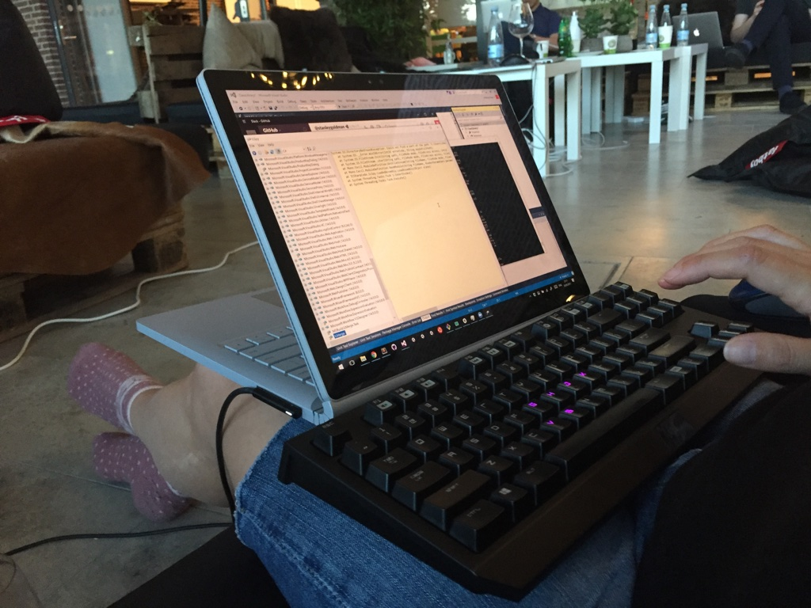
Notes:
I've worked remotely for 11 years now, which is why I can be in Lisbon this week to talk to you without affecting my work schedule too much.
Tomorrow I'll probably find a nice spot somewhere on the beach and work from there, the weather is waaaaay nicer here than in Copenhagen.
In a few weeks I'll be in San Francisco, then probably New York.
The only thing I need is my laptop, or laptops, power, and a decent internet connection.
The best thing that's happened is the european roaming, which means I can have data anywhere in Europe without having to worry about it.
I carry a couple of phones with me since I have a few different sim cards for a few different countries where I spend more time, but a couple of months ago I switched to a plan that gives me 10GB of data roaming globally, so I don't have to worry about having local sim cards anymore (although I do have a US sim card, it's pretty handy, they get very confused when you give them a non-US phone number)

Slide 14
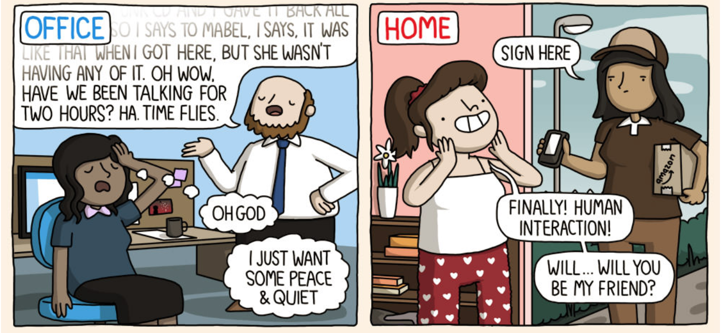
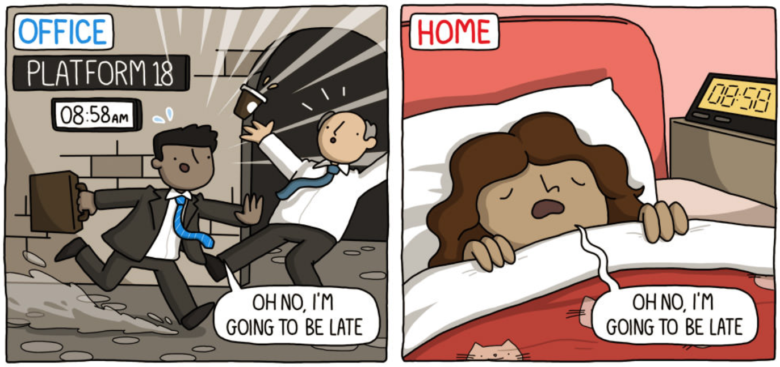
Notes:
Remote life means that you are in control over your schedule. You're not going into a physical office every day, no one can look in and see where you are physically.
This gives you a lot of freedom to make your own schedule, but it's not easy and not everyone can handle it.
Most of the time there's no people right next to you that you can turn to for a chat. Most of the time there's no people at all unless you go out to them.
Your colleagues are in another country, in another timezone, they might not be awake at the same hours that you are. It can get very lonely, and without the constant realtime feedback of a location where you go every day with your colleagues, it can feel like no one sees you, that you're working in a vacuum.
It's your job to reach out and make connections, keep your routine and your schedule despite the lack of external pressures, do the work regardless of whether there's someone around you.

Slide 15
How did I get here?
Notes:
Companies pay me to work on open source. Crazy, yes, I know.
Open source is a profitable business and every successful company out there uses open source in one way or another, and it is in their best interest to hire and retain developers that work on these projects.

Slide 16
My first
open source job
Notes:
Around 2006 I was here in Lisbon and had finished a consulting project at an insurance company - building a website or something of the sort. By this time I'd been following the mailing lists of several open source projects like Mono and Umbraco, and had used some of them to build internal tools at various places and projects I worked at. I had done a couple of posts and sent some patches in, so I had some history in the mailing lists.
So when one day Miguel de Icaza posted on the mono mailing list that they were looking to hire a developer for the Mono team, I was ready for it and immediately applied. The whole hiring process was done remotely via email, and before I knew it I was a Novel employee working full time on open source software.

Slide 17
the takeaway:
participate
Notes:
If I wasn't monitoring that mailing list, I wouldn't have seen that job posting. If I wasn't sending patches and posting on forums and following the project, I wouldn't have been on that mailing list and I wouldn't have had code to point to when it came time for interviewing.

Slide 18
Conferences
Opportunities
Networking
Visibility
Connections
Contributions
Notes:
Open source == visibility
Open source development is a very effective way of making connections in the industry and making yourself be seen, which is the best way of getting more job opportunities.
Even if it's not what you do for work, it's still the best way of boosting your career and getting those jobs that seem completely out of reach.

Slide 19
dotnet Fringe
GUADEC
OSCON
MonkeySpace
Conferences
NDC
dotnetConf
CodeMesh
FOSDEM
44con
Notes:
One of the first things I did was look for open source conferences that I could afford to attend. Novell didn't really give us a conference benefit, but I felt it was important that I connected with people and so I went to FOSDEM and GUADEC and other conferences whenever I could, paying out of my own pocket.
I spent more time in the corridors talking to people than I did watching talks, and that was really important.
It was at FOSDEM that I met Lucas Meijer, then the lead of the scripting team at Unity, and helped him figure out some problems he was having with the Mono runtime. Some time later, he offered me a job.

Slide 20
the takeaway:
connect
Notes:
The friends and contacts I made over the years on mailing lists, discussion groups, IRC, social media and other forums eventually led to the jobs and contracts. I decided to take a year to rest and figure out what my next job would be, and ended up spending that year on a wide variety of projects, all of which came through friends and connections, over conversations at conferences and bars - I even spent a month in Jordan helping bootstrap a game studio.
I met Phil Haack, my current boss, at another conference, and we bumped into each other a few times in different conferences. When he was hiring to do GHfVS, he pinged me asking if I was interested, and now I'm at GitHub.

Slide 21
Google Summer of Code
Game jams
Coding challenges
Hackathons
Notes:
Google Summer of Code is a 3 month open source paid internship where you get to work on an OSS project for one of the many mentoring organizations in the program. A successful GSoC project is an excellent launch platform for you career.
I've mentored students on Google Summer of Code for 7 years. I've had two very successful students that went on to get hired later. Both these students were full time at the university while doing GSoC, and both ended up doing GSoC for two years in a row. The common characteristics they both had was that they were very engaged, very committed, very independent. One of the most common scenarios in a disappointing GSoC project is that the student gets distracted by something and disappears for a few days. Then they come back, and then they disappear again, and that pattern repeats itself and before you know it, the 3 months are over and the project isn't done. Successful students don't fall into this pattern. They might need to step away to deal with exams and other things, but they come back and they are fully committed when they're working on the project.
They self-organize and self-plan. They don't wait for the mentor to tell them what to do. They request feedback but aren't blocked by it. They make goals and they make them happen.

Slide 22
make your own deadlines
the takeaway:
be independent
be your own boss
Notes:
You're still in university. Your schedule is mostly controlled by outside forces - you have a calendar, assignments to do, exams to take, studies to study. To make a name for yourself and break into the tech industry and open source, though, you need to go out for yourself and find projects and programs that excite you and work on them even if no one is looking over your shoulder. If you need to pretend someone is whipping you to do this, then do that. I usually set deadlines for myself when working on things and see how good I am at judging how long things take. It's a good skill to develop

Slide 23
Why are you here?
Notes:
Why are you at University? What do you hope to get out of it? University gives you an unique opportunity to sample multiple areas so you can figure out what you like and don't like. Don't expect to come out of it knowing everything there is to know on a subject, and take this time instead to figure out what the different parts are.

Slide 24
What sort of job do you want?
Notes:
Figure out what interests you, and go find people that are working on that and projects that tackle that.

Slide 25
How?
test / find bugs
write docs
help/organize events
write code
submit patches
help administer infrastructure
help on forums
Notes:
Whether you are just getting started in open source or trying to build a community around your project, you should decide what else you want out of a project. Communities come in all shapes and sizes.
Participating in Open Source can be more than just pushing code around

Slide 26
500 candidates
What I look for
when I hire
2 positions
Notes:
When we went through our latest round of hiring, we had 500 candidates to go through. We had to get that list down to 2. All our projects are open source. The links to the repos were in the job posting.

Slide 27
take a guess
How many
participated?
Notes:
Can you guess how many of the 500 candidates took the time to check out the projects and comment on issues? I'm not even talking about sending in patches, just installing the extension, trying it out, and then going in to the repository and leaving a couple of comments on their experience.

Slide 28
All the world's a stage
Notes:
The biggest benefit of open source is worldwide reach, especially when coming from countries that are not at the center of the tech world. When looking for career growth, with open source you now have the whole world open to you. The work you do in open source is visible across the globe. That translates into a much wider market for opportunities, faster career growth and better salaries.

Slide 29
Go forth and OSS!
Questions anyone?
@sh4na
Andreia Gaita

Slide 30
Text
Text
Text
Text
Text
Text
Text

